Slide 1
Course 3 – HTTP API calls. Jetpack Compose navigation. Local persistence

Slide 2
REST using Retrofit
https://square.github.io/retrofit/

Slide 3
REST using Retrofit
implementation "com.squareup.retrofit2:retrofit:version" implementation "com.squareup.retrofit2:adapter-rxjava2:version" implementation "com.squareup.retrofit2:converter-gson:version"
implementation “io.reactivex.rxjava2:rxandroid:version"
https://square.github.io/retrofit/

Slide 4
REST using Retrofit
interface MovieService {
@GET("movies")
val movies: Observable<List<Movie>>
@POST("update")
fun update(@Body movie: Movie): Observable<Movie>
@GET("genres")
val genres: Observable<List<String>>
@DELETE("delete/{id}")
fun delete(@Path("id") id: Int): Observable<ResponseBody>
@GET("moviesByGenre/{genre}")
fun moviesByGenre(@Path("genre") genre: String)
: Observable<List<Movie>>
@POST("add")
fun add(@Body movie: Movie): Observable<Movie>
@GET("details/{id}")
fun details(@Path("id") id: Int): Observable<Movie>
companion object {
const val SERVICE_ENDPOINT = “http://SERVER_IP:2022”
}
@POST("updateDescription")
fun updateDescription(@Body movie: Movie): Observable<Movie> }
@POST("updateRating")
fun updateRating(@Body movie: Movie): Observable<Movie>
https://square.github.io/retrofit/

Slide 5
Navigation

Slide 6
Key concepts
https://developer.android.com/guide/navigation

Slide 7
Navigation
Navigation Components:
A collection of libraries
A plugin
Tooling

Slide 8
Navigation
Navigation Graph
NavHostFragment
NavController

Slide 9
Navigation
https://developer.android.com/guide/navigation

Slide 10
Navigation Drawer
App main navigation menu.
Hidden when not in use.
Appears:
with a left swipe from the screen edge
when the user touches the drawer icon in the app bar
https://developer.android.com/training/implementing-navigation/nav-drawer

Slide 11
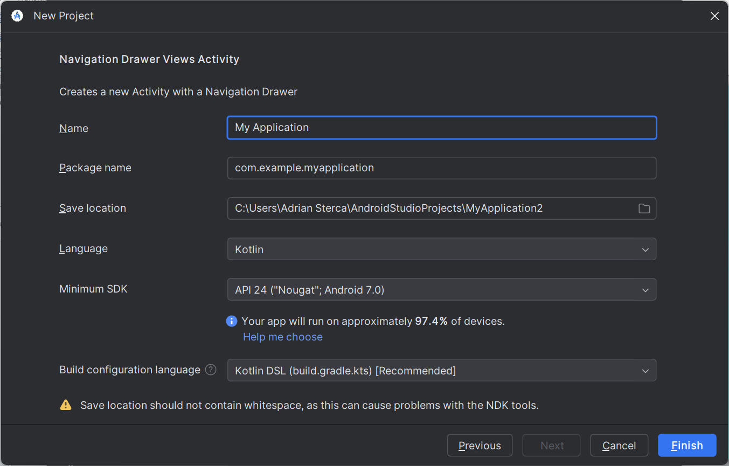
Create a navigation drawer views activity project

Slide 13
Generated Artifacts (xml)
Sources
Layouts
Menus
Navigation

Slide 14
Dependencies
buildscript { ext.nav_version = “2.5.3”
}
… dependencies {
implementation "androidx.navigation:navigation-fragment-ktx:$nav_version" implementation "androidx.navigation:navigation-ui-ktx:$nav_version"
}

Slide 15
Add a drawer to a layout
<?xml version="1.0" encoding="utf-8"?>
<androidx.drawerlayout.widget.DrawerLayout xmlns:android="http://schemas.android.com/apk/res/android" xmlns:app="http://schemas.android.com/apk/res-auto" xmlns:tools="http://schemas.android.com/tools" android:id="@+id/drawer_layout" android:layout_width="match_parent" android:layout_height="match_parent" android:fitsSystemWindows="true" tools:openDrawer="start">
<include layout="@layout/app_bar_main" android:layout_width="match_parent"
android:layout_height="match_parent" />
<com.google.android.material.navigation.NavigationView android:id="@+id/nav_view" android:layout_width="wrap_content" android:layout_height="match_parent" android:layout_gravity="start" android:fitsSystemWindows="true" app:headerLayout="@layout/nav_header_main" app:menu="@menu/activity_main_drawer" />
</androidx.drawerlayout.widget.DrawerLayout>

Slide 16
Declare the menu items
<android.support.design.widget.NavigationView
android:id=“@+id/nav_view”
android:layout_width=“wrap_content”
android:layout_height=“match_parent”
android:layout_grvity=“start”
android:IfitsSystemWindows=“true”
app:menu=“@menu/activity_main_drawer” />
<?xml version="1.0" encoding="utf-8"?>
<menu xmlns:android=http://schema.android.com/apk/res/android >
<group android:checkableBehavior=“single”>
<item
android:id="@+id/nav_camera" android:icon="@drawable/ic_menu_camera"
android:title="@string/import" />
<item
android:id="@+id/nav_gallery" android:icon="@drawable/ic_menu_gallery"
android:title="@string/gallery" />
<item
android:id="@+id/nav_slideshow" android:icon="@drawable/ic_menu_slideshow" android:title="@string/slideshow" />
...
</group>
</menu>

Slide 17
Add a header to the
nav drawer
<android.support.design.widget.NavigationView
android:id=“@+id/nav_view”
android:layout_width=“wrap_content”
android:layout_height=“match_parent”
android:layout_grvity=“start”
android:IfitsSystemWindows=“true”
app:menu=“@menu/activity_main_drawer”
app:headerLayout=“@layout/nav_header_main”/>
<?xml version="1.0" encoding="utf-8"?>
<LinearLayout xmlns:android=http://schema.android.com/apk/res/android >
android:layout_width=“match_parent”
android:layout_height=“192dp”
android:background="?attr/colorPrimaryDark"
android:padding="16dp"
android:theme="@style/ThemeOverlay.AppCompat.Dark"
android:orientation="vertical"
android:gravity="bottom">
<TextView
android:layout_width="match_parent"
android:layout_height="wrap_content"
android:text="My header title"
android:textAppearance="@style/TextAppearance.AppCompat.Body1"/>
</LinearLayout>

Slide 18
Handle navigation events
class MainActivity : AppCompatActivity() {
private lateinit var appBarConfiguration: AppBarConfiguration
override fun onCreate(savedInstanceState: Bundle?) { super.onCreate(savedInstanceState) setContentView(R.layout.activity_main) setSupportActionBar(toolbar)
val navController = findNavController(R.id.nav_host_fragment) appBarConfiguration = AppBarConfiguration(
setOf(
R.id.nav_home, R.id.nav_gallery
), drawer_layout
)
setupActionBarWithNavController(navController, appBarConfiguration) nav_view.setupWithNavController(navController)
}
}

Slide 19
Local Persistence Options
Internal storage
Internal cache files
External storage
Shared preferences
Databases
https://developer.android.com/guide/topics/data/

Slide 20
Options
•On device:
•SQLite
•Realm
•Room
•SQLDelight
•ObjectBox
•On cloud:
•Firebase Realtime Database
•Firebase Firestore
•Couchbase Lite

Slide 21
SQLite
Define a schema and a contract
object FeedReaderContract {
// Table contents are grouped
// together in an anonymous object. object FeedEntry : BaseColumns { const val TABLE_NAME = "entry"
const val COLUMN_NAME_TITLE = "title"
const val COLUMN_NAME_SUBTITLE = "subtitle"
}
}
https://developer.android.com/training/data-storage/sqlite

Slide 22
SQLite Helper
Create a database using an SQL helper
private const val SQL_CREATE_ENTRIES = """ CREATE TABLE ${FeedEntry.TABLE_NAME} (
${BaseColumns._ID} INTEGER PRIMARY KEY,
${FeedEntry.COLUMN_NAME_TITLE} TEXT,
${FeedEntry.COLUMN_NAME_SUBTITLE} TEXT) """
private const val SQL_DELETE_ENTRIES =
"DROP TABLE IF EXISTS ${FeedEntry.TABLE_NAME}"

Slide 23
SQLite
class FeedReaderDbHelper(context: Context) :
SQLiteOpenHelper(context, DATABASE_NAME, null, DATABASE_VERSION) {
override fun onCreate(db: SQLiteDatabase) { db.execSQL(SQL_CREATE_ENTRIES)
}
override fun onUpgrade(db: SQLiteDatabase, oldVersion: Int, newVersion: Int) {
// This database is only a cache for online data, so its upgrade policy is
// to simply to discard the data and start over db.execSQL(SQL_DELETE_ENTRIES)
onCreate(db)
}
override fun onDowngrade(db: SQLiteDatabase, oldVersion: Int, newVersion: Int) { onUpgrade(db, oldVersion, newVersion)
}
companion object {
// If you change the database schema, you must increment the database version. const val DATABASE_VERSION = 1
const val DATABASE_NAME = "FeedReader.db"
}
}

Slide 24
SQLite - Insert
// Gets the data repository in write mode val db = dbHelper.writableDatabase
// Create a new map of values, where column names are the keys val values = ContentValues().apply {
put(FeedEntry.COLUMN_NAME_SUBTITLE, subtitle)
}
// Insert the new row, returning the primary key value of the new row val newRowId = db?.insert(FeedEntry.TABLE_NAME, null, values)

Slide 25
SQLite - Query
val dbHelper = FeedReaderDbHelper(context)
val db = dbHelper.readableDatabase
// Define a projection that specifies which columns from the database
// you will actually use after this query. val projection = arrayOf(
BaseColumns._ID, FeedEntry.COLUMN_NAME_TITLE, FeedEntry.COLUMN_NAME_SUBTITLE)
// Filter results WHERE "title" = 'My Title'
val selection = "${FeedEntry.COLUMN_NAME_TITLE} = ?" val selectionArgs = arrayOf("My Title")
// How you want the results sorted in the resulting Cursor
val sortOrder = "${FeedEntry.COLUMN_NAME_SUBTITLE} DESC" val cursor = db.query(

Slide 26
SQLite - Query
val dbHelper = FeedReaderDbHelper(context) val db = dbHelper.readableDatabase
val projection = arrayOf(...)
val selection = "${FeedEntry.COLUMN_NAME_TITLE} = ?" val selectionArgs = arrayOf("My Title")
val sortOrder = "${FeedEntry.COLUMN_NAME_SUBTITLE} DESC" val cursor = db.query(...)
val itemIds = mutableListOf<Long>() with(cursor) {
while (moveToNext()) {
val itemId = getLong(getColumnIndexOrThrow(BaseColumns._ID)) itemIds.add(itemId)
}
}

Slide 27
SQLite - Delete
val dbHelper = FeedReaderDbHelper(context) val db = dbHelper.writableDatabase
// Define 'where' part of query.
val selection = "${FeedEntry.COLUMN_NAME_TITLE} LIKE ?"
// Specify arguments in placeholder order. val selectionArgs = arrayOf("MyTitle")
// Issue SQL statement.
val deletedRows = db.delete(FeedEntry.TABLE_NAME, selection, selectionArgs)

Slide 28
SQLite - Update
val dbHelper = FeedReaderDbHelper(context) val db = dbHelper.writableDatabase
// New value for one column val title = "MyNewTitle"
val values = ContentValues().apply { put(FeedEntry.COLUMN_NAME_TITLE, title)
}
// Which row to update, based on the title
val selection = "${FeedEntry.COLUMN_NAME_TITLE} LIKE ?" val selectionArgs = arrayOf("MyOldTitle")
val count = db.update( FeedEntry.TABLE_NAME, values,
)

